Slide 1


Git and GitHub
CMPUT 301
Winter 2023
Junwen Shen
These slides are mostly created by Akalanka Galappaththi
Git merge conflict demo is based on LN Wilson’s lab worksheet (Dept. Math. & Computer Since, University of Lethbridge)

Slide 2
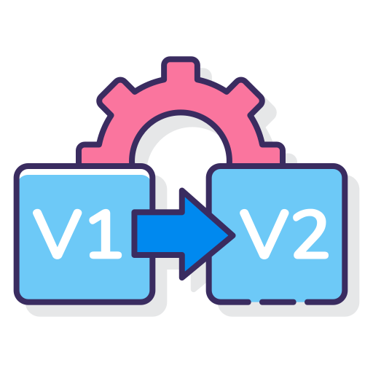
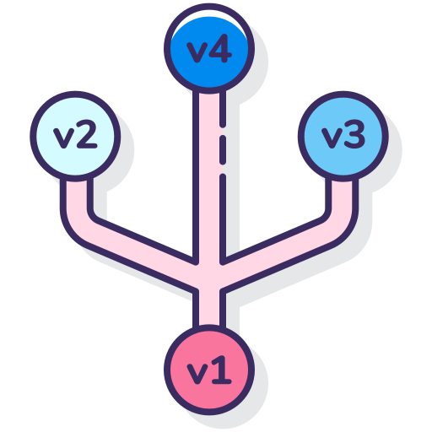
What is Git
Git is a version control tool.
Keep track of changes (files).
Revert back to previous state.
www.flaticon.com

Slide 3


What is GitHub
Distributed version control system.
Offers source code management (Git).
Many other (own) services.
www.flaticon.com

Slide 4
Installing Git
Windows users: download and run the .exe file
Mac users: (Homebrew package manager)
Linux users
https://git-scm.com/downloads
Installation guide
https://www.stanleyulili.com/git/how-to-install-git-bash-on-windows/
!!! Make sure to select your preferred editor

Slide 5
Installing Git
Windows users: download and run the .exe file
Mac users: (Homebrew package manager)
Linux users
$ brew install git
$ git --version

Slide 6
Installing Git
Windows users: download and run the .exe file
Mac users: (Homebrew package manager)
Linux users
$ sudo apt update
$ sudo apt install git
$ git --version
$ sudo yum install git
$ git --version

Slide 7
Configure Git
Set up your name and email
$ git config --global user.name “John Smith”
$ git config --global user.email js@gmail.com
You need an editor installed in your computer
Set up preferred editor
$ git config --global core.editor emacs
$ git config --global core.editor vim
$ git config --global core.editor nano
$ git config --global core.editor “code --wait”
https://swcarpentry.github.io/git-novice/02-setup/
More on setting up editors

Slide 8
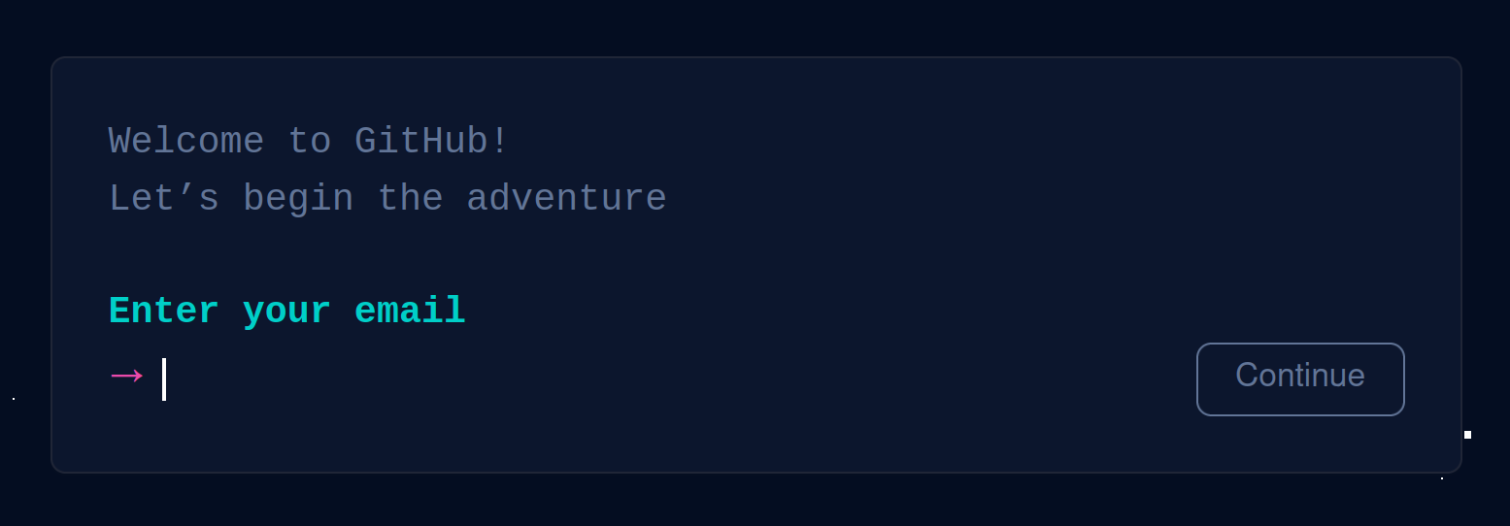
Hosting your repo in GitHub
First things first: you need a GitHub account (don’t have one, go ahead and create one)
https://github.com/signup?ref_cta=Sign+up&ref_loc=header+logged+out&ref_page=%2F&source=header-home

Slide 9
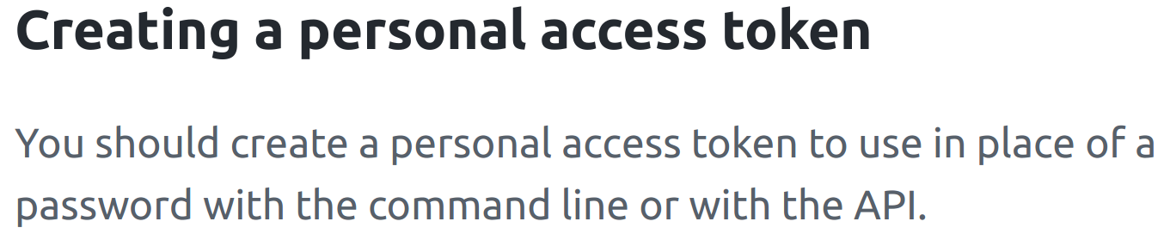
Hosting your repo in GitHub
You need personal access tokens to access GitHub (because we are going to use the CMD tool)
https://docs.github.com/en/authentication/keeping-your-account-and-data-secure/creating-a-personal-access-token

Slide 10
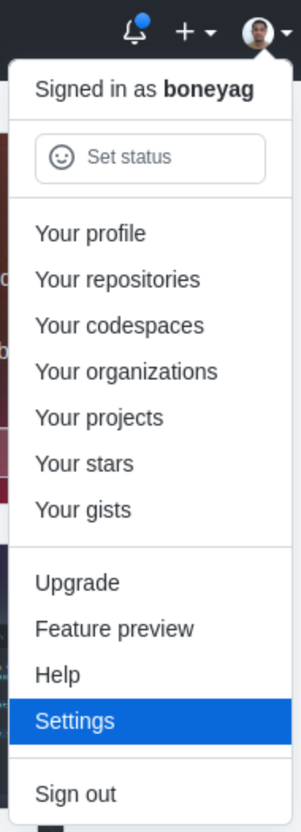
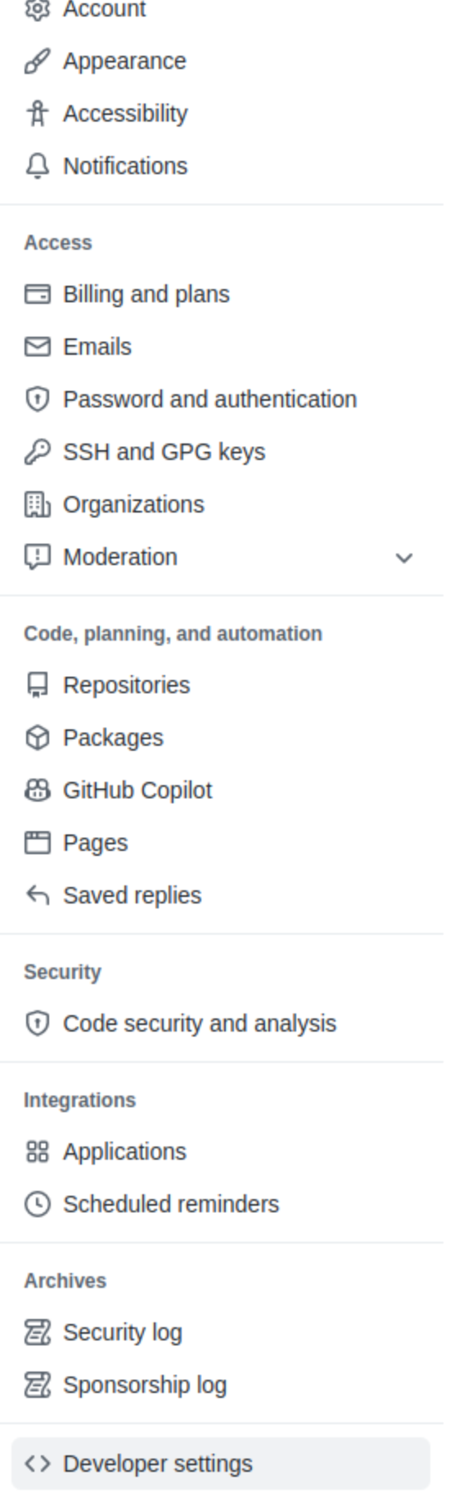
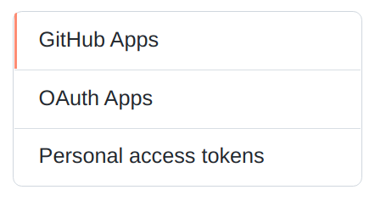
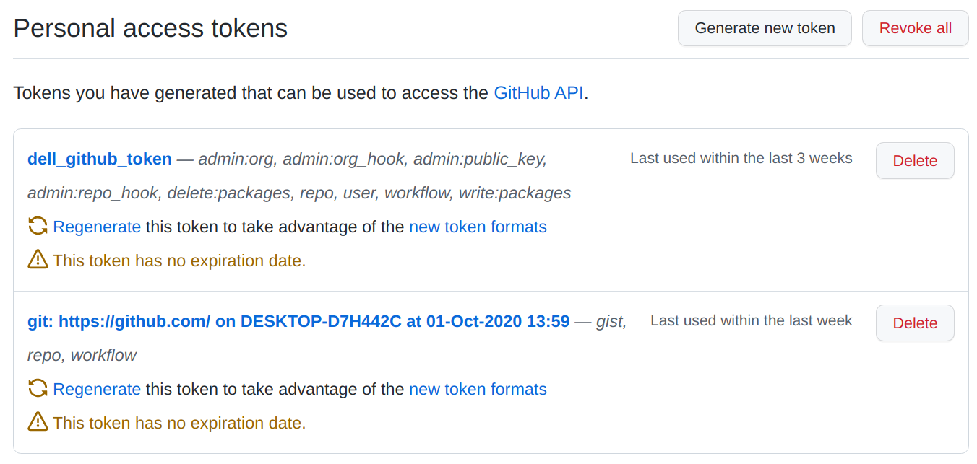
We are going to follow the GitHub docs
I have some tokens created already. In your case it might be empty.

Slide 11
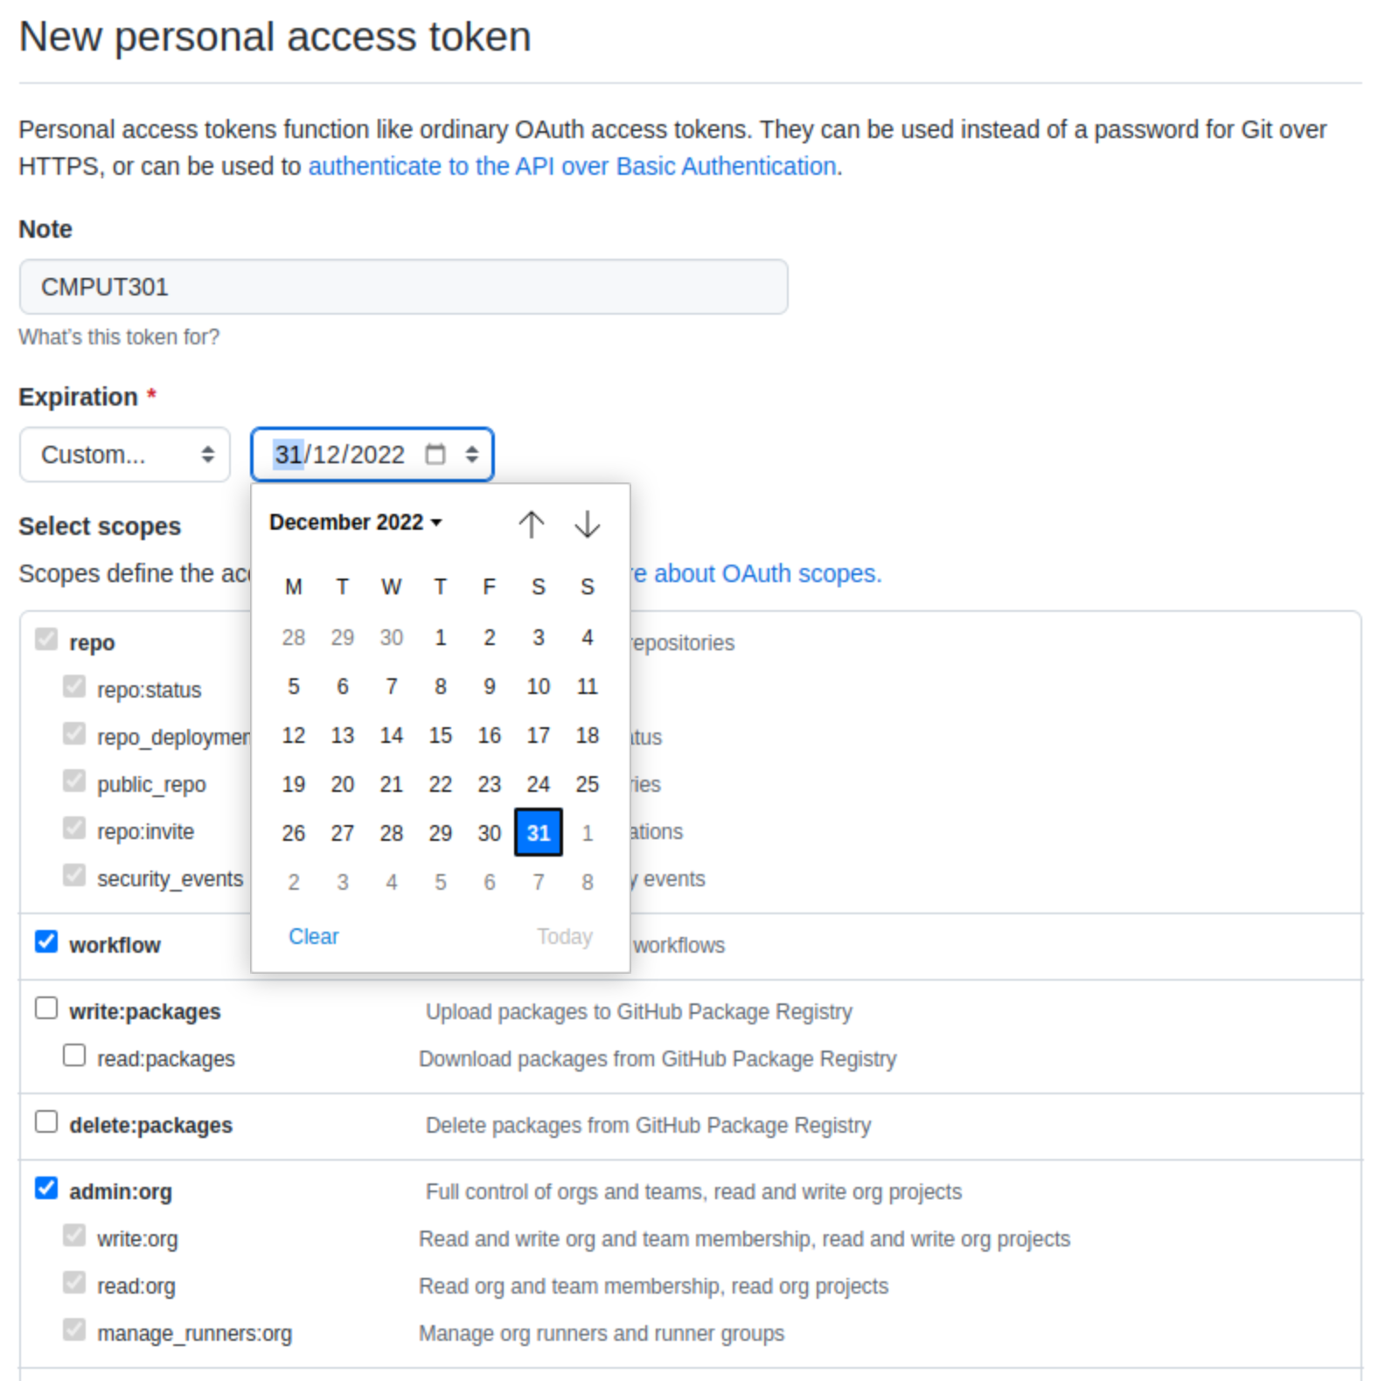
Continue...
Not super important, but use a meaningful name so that you know the purpose
Important: keep until you finish the course
You may read the scope for more information. But these three option should enough for the project.

Slide 12
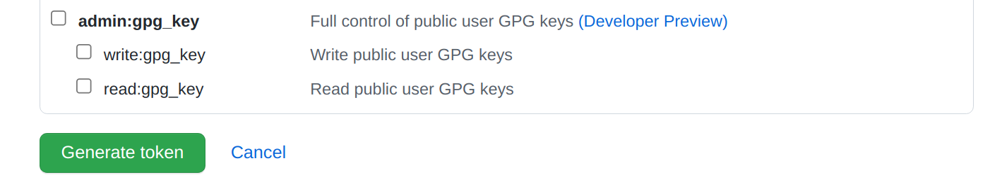
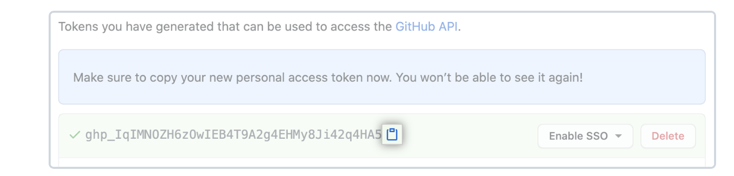
Continue...
Click on the generate token
Copy the token to a file, because you will not able to see it!!!!
When using git push/pull, you use the PAT instead of password.
If you need to store your PAT, follow this discussion in SO (at your own risk).
Read more about PAT: creating-a-personal-access-token

Slide 13
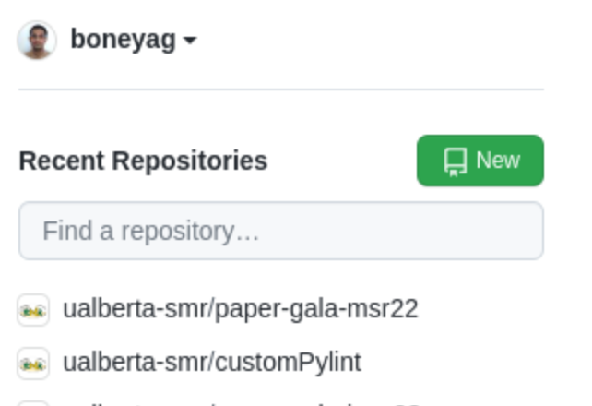
Create a repo in GitHub
Visit the URL on your browser.
Create a repo.
https://github.com/

Slide 14
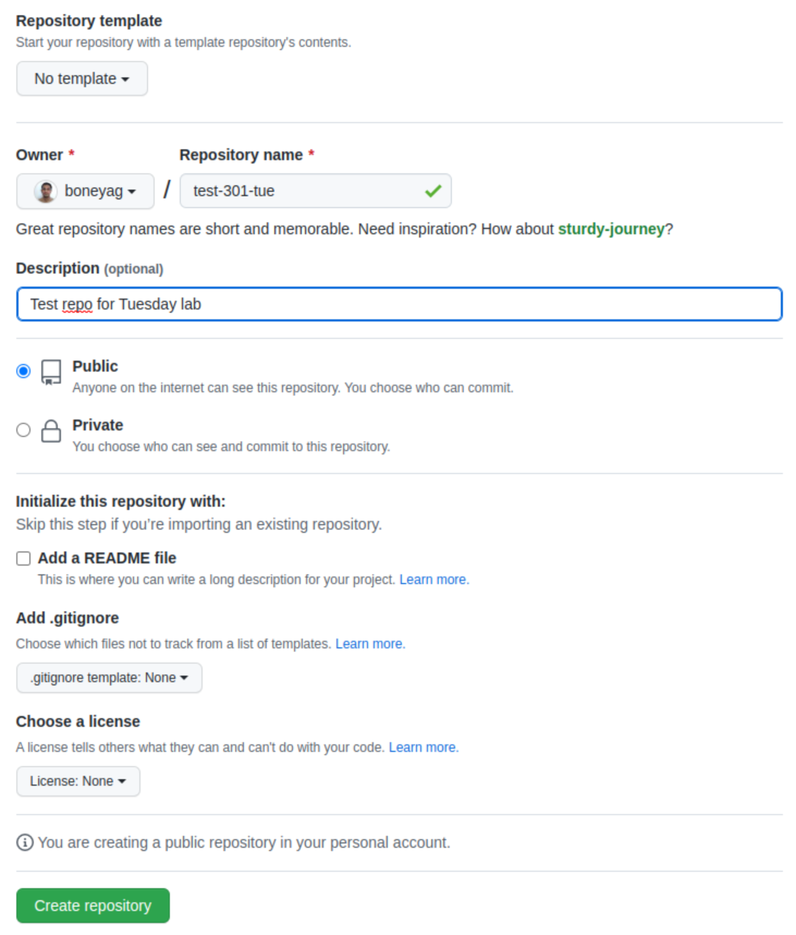
Create a repo in GitHub
Short memorable name
Who could see your repo
Automatically create some files

Slide 15
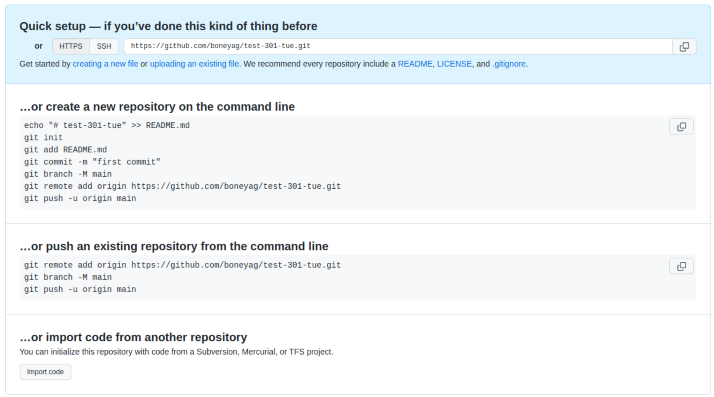
Use the https opt. (ssh is out of the scope)
Your username
Your repo name
Copy URL and paste on the terminal (make sure you to change dir to a desired location

Slide 16
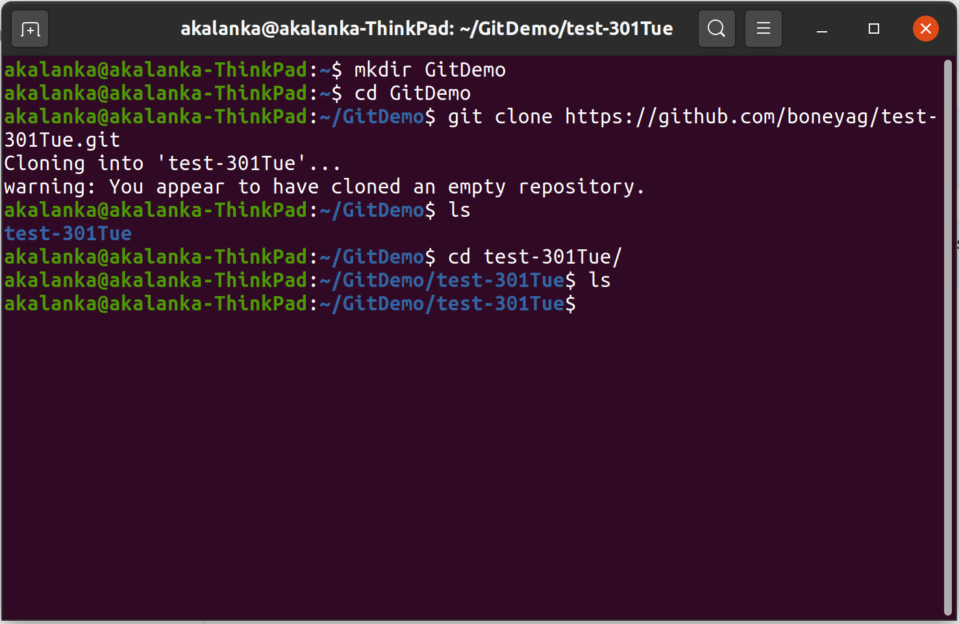
Clone a Git repo
Make a dir
Change the dir
Use the command git clone
Copy git URL after
Hit return
**Use git clone when copy the repo to your computer for the first time. After that we use git pull.

Slide 17
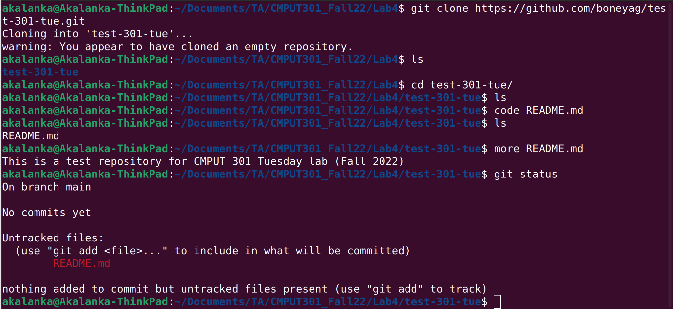
Add a file to the repo locally

Slide 18
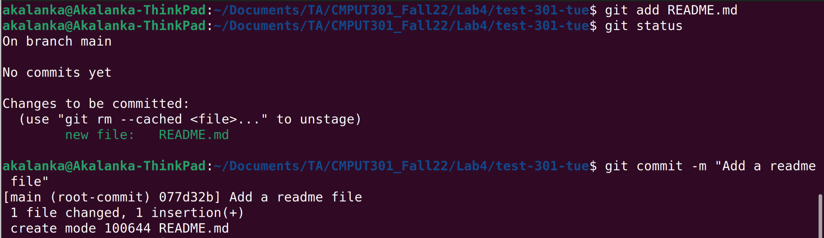
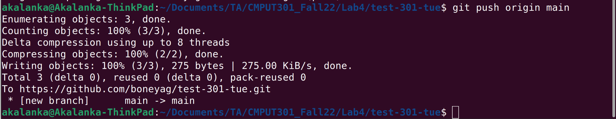

Slide 19
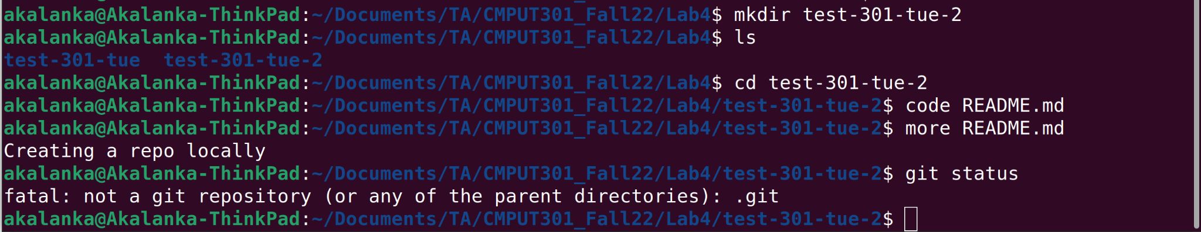
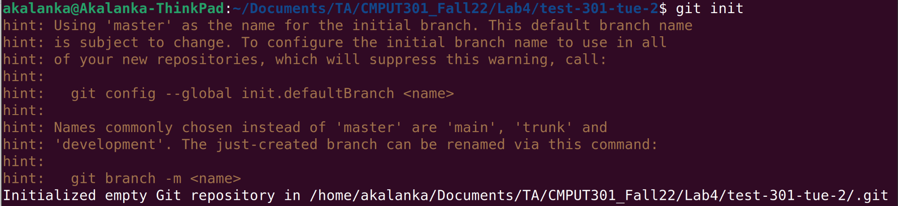
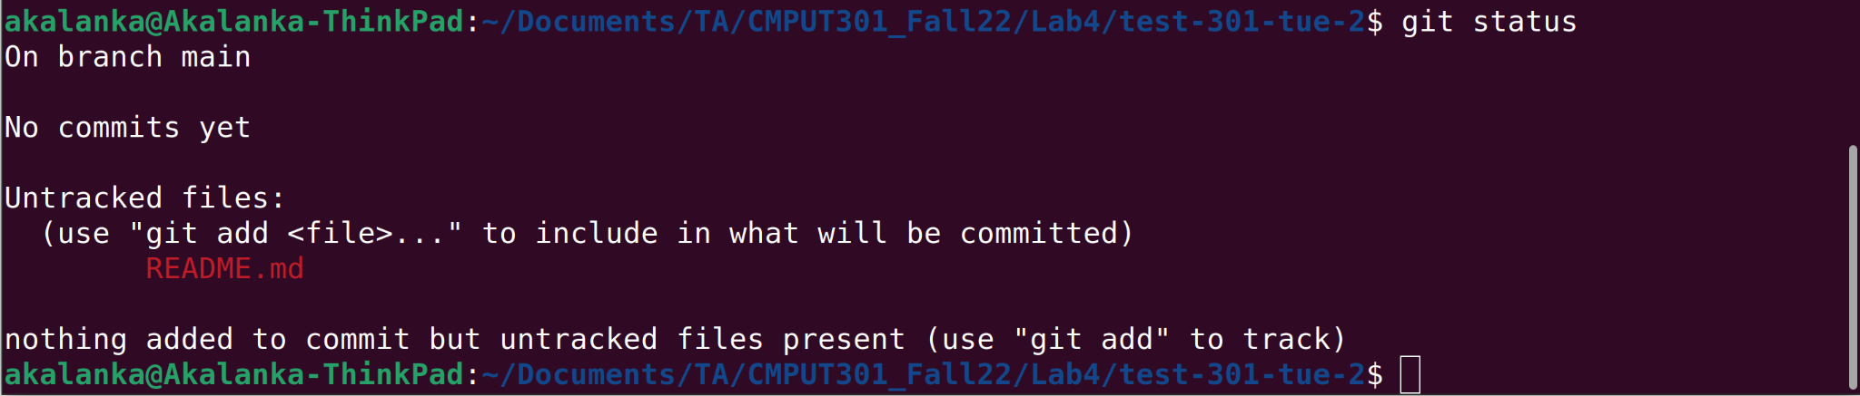
Create a repo locally
code README.md
git init
git status
git add README.md
git status
git commit -m “<message>”
git remote add origin <URL>
git push origin master

Slide 20
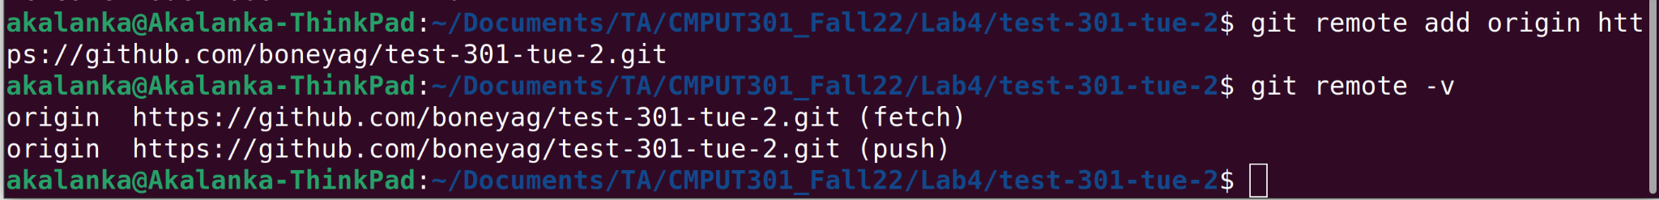
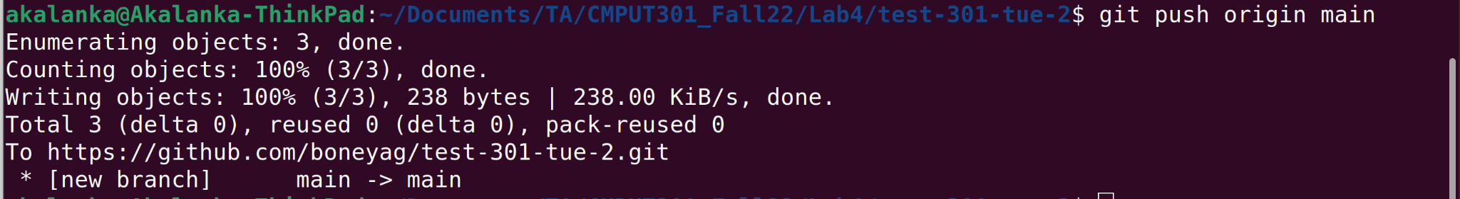

Slide 21
Git workflow
GitHub
git push/pull origin <branch name>
.git directory (repo)
git checkout <branch name>
git commit -m <msg>
Working directory
Staging area
git add <file name>
git rm --cached <file name>

Slide 22
Practice the common commands
Create two new text files and push those to Github repo
echo “Test 1” >> test1.txt
echo “Test 2” >> test2.txt
git add - A
git commit -m “<message>”
git push origin master
Useful git commands
git pull origin <branch>
git reset - remove files from the staging area
git rm --cached <filename> - remove a file from working index
git rm -f <filename> - remove a file forcefully (-f)
git rm -rf <dir name> - remove a directory forcefully (-r recursively)
git log - view commit history
git clone <https URL>

Slide 23



Merge conflicts
Ex: Modifying files in the project.
TM1: change file1
TM2: change file2
Both push changes
TM1: change file1 -> push
TM2: change file1, file2 -> try to push
https://www.flaticon.com/

Slide 24
Let’s get your hands dirty -- demo a merge conflict
Leave the current repo dir (cd ..), open two terminals (pretend those as two users of the repo).
Make sure to follow the order of execution of commands.
Terminal 1
Terminal 2
1 | mkdir t1 | mkdir t2
2 | cd t1
3 | git clone <your repo URL> | cd t2
4 |  | git clone <your repo URL>
5 |  | cd test-301-tue
6 |  | mkdir one
7 |  | echo “Lin1” >> one/file1.txt

Slide 25
Let’s get your hands dirty -- demo a merge conflict
8 |  | git status
9 |  | git add one/file1.txt
10 |  | git commit -m “informative-message”
11 |  | git push origin main
12 | cd test-301Tue
13 | git pull origin main
14 | mkdir two
15 | code two/file2.txt
16 | git add two/

Slide 26
Let’s get your hands dirty -- demo a merge conflict
17 | git commit -m “<msg>”
18 | git push origin main
19 |  | cd one
20 |  | code file1.txt # add two lines
21 |  | git add file1.txt
22 |  | git commit -m “<msg>”
23 |  | git push origin main
24 |  | git fetch origin
25 |  | git merge origin main
No conflict as users pushed different files
Will not push until you pull remote changes

Slide 27
Let’s get your hands dirty -- demo a merge conflict
26 |  | git push origin main
27 | git pull origin main
28 | code two/file2.txt
29 | git add two/file2.txt
30 | git commit -m “<msg>”
31 | git push origin main
32 |  | cd two
33 |  | code file2.txt
34 |  | git add two/file2.txt
Need to pull changes from origin
Add two more lines
No conflict as users pushed different files
Add two more lines

Slide 28
Let’s get your hands dirty -- demo a merge conflict
35 |  | git commit -m “<msg>”
36 |  | git push origin main
37 |  | git fetch origin
38 |  | git merge origin main
39 |  | # Fix the conflict as you see fit #
40 |  | git add two/
41 |  | git commit -m “<msg>”
42 |  | git push origin master
43
Need to pull changes from origin
Conflict

Slide 29
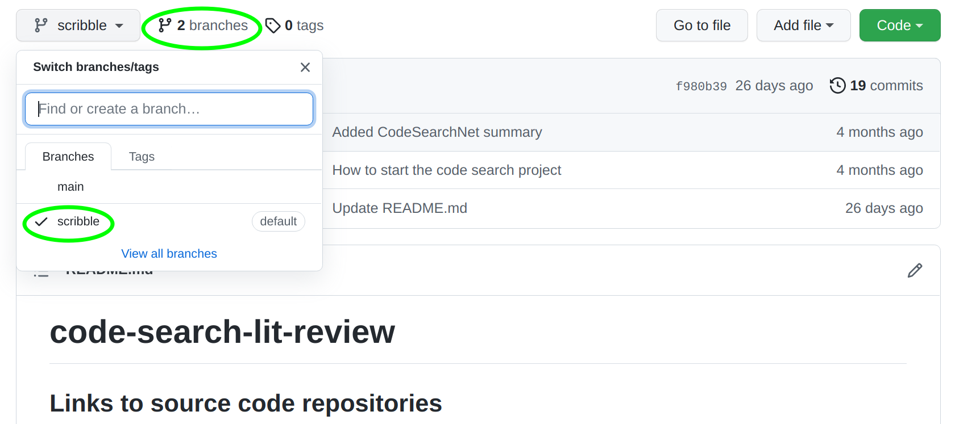
Git branches

Slide 30
Git branches
What is a branch?
Branch shows the evolution of your project (commits)
Each commit has SHA-1 value which allows you to revert back to that state.
main

Slide 31
Git branches
Default branch -- main
Nothing special about this branch.
You can rename it.
Nobody bother to do that, so that it remains with the default name.
Create a branch in command line
git branch test
main
test

Slide 32
Git branches
Current working branch
Change the branch
git status
*
main
test

Slide 33
Git branches
Current working branch
Change the branch
git status
git checkout test
main
*
test

Slide 34
Git branches
Do some work on test branch
git checkout test
code two/file2.txt
git add two/
git commit -m “<msg>”
git push origin test
code one/file2.txt
git add one/
git commit -m “<msg>”
git push origin test
main
*
test

Slide 35
Git branches
Merge test to master
git checkout main
git merge test
*
main
test

Slide 36
Git branches
Merge test to master
git checkout master
git merge test
git branch -d test (delete local)
git push -d origin test (delete remote)
*
main

Slide 37
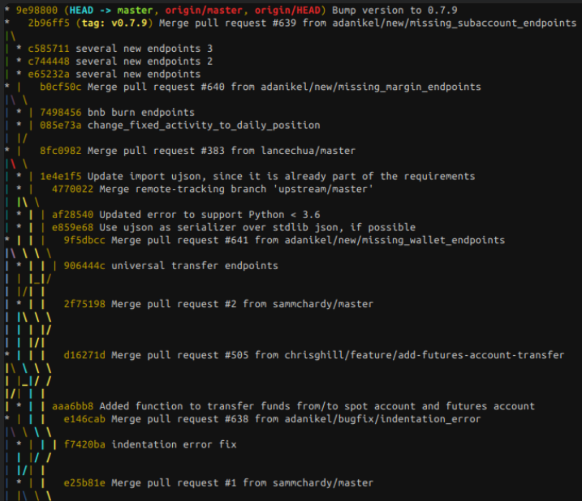
Git branches
Visualize your branches
git log --oneline --decorate --graph --all
Practice more: https://learngitbranching.js.org/?locale=en_US
Source: https://tech.serhatteker.com/post/2021-02/git-log-tree/

Slide 38
Skip files from adding to the staging area
.gitignore is a special file that contains file patterns that skip when adding files to the staging area
https://github.com/github/gitignore
# IntelliJ
*.iml
.idea/workspace.xml
.idea/tasks.xml
.idea/gradle.xml
.idea/assetWizardSettings.xml
.idea/dictionaries
.idea/libraries

Slide 39
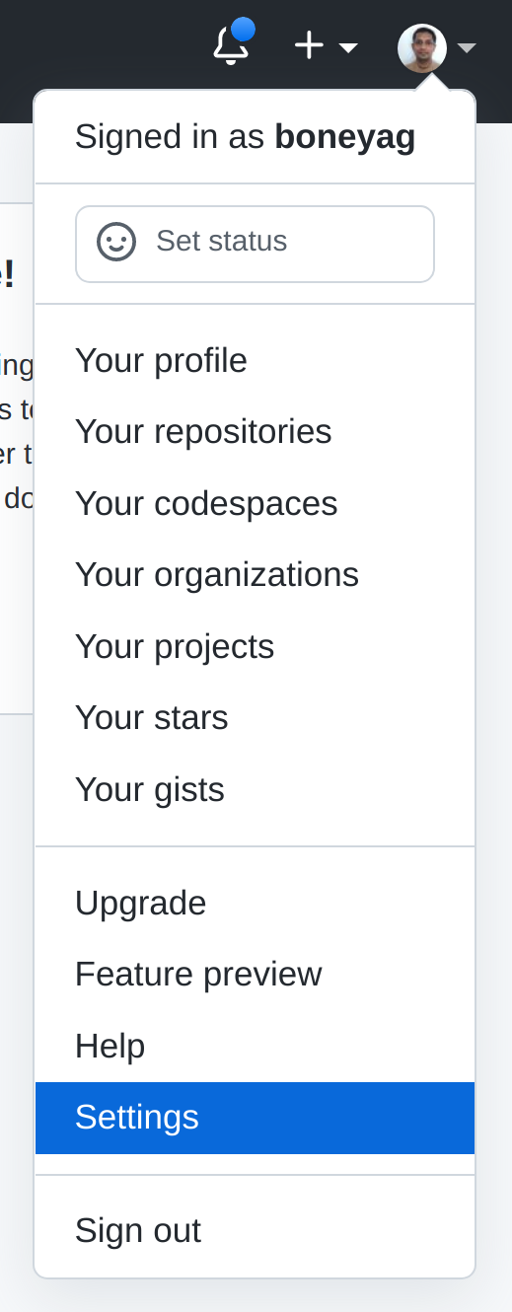
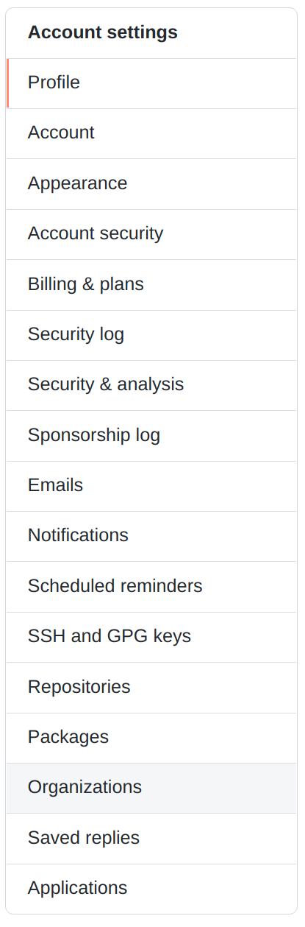
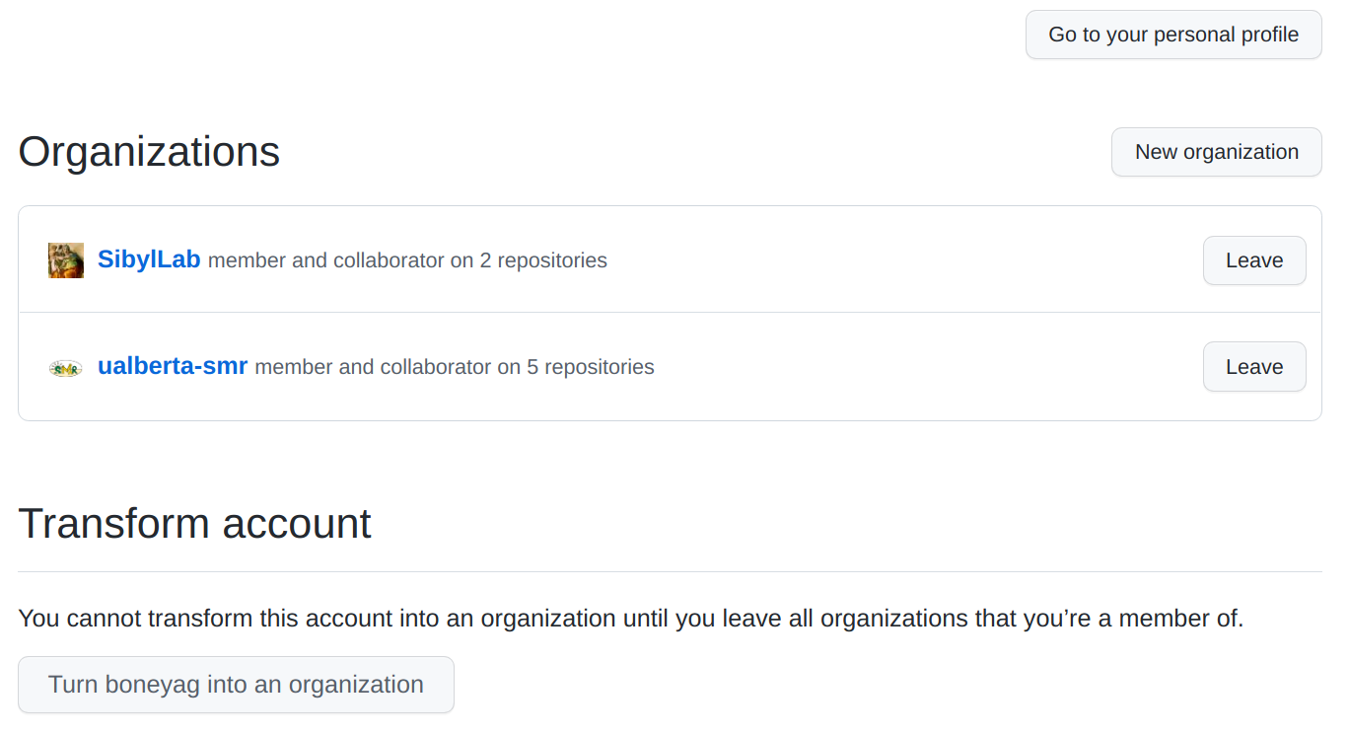
GitHub organization

Slide 40
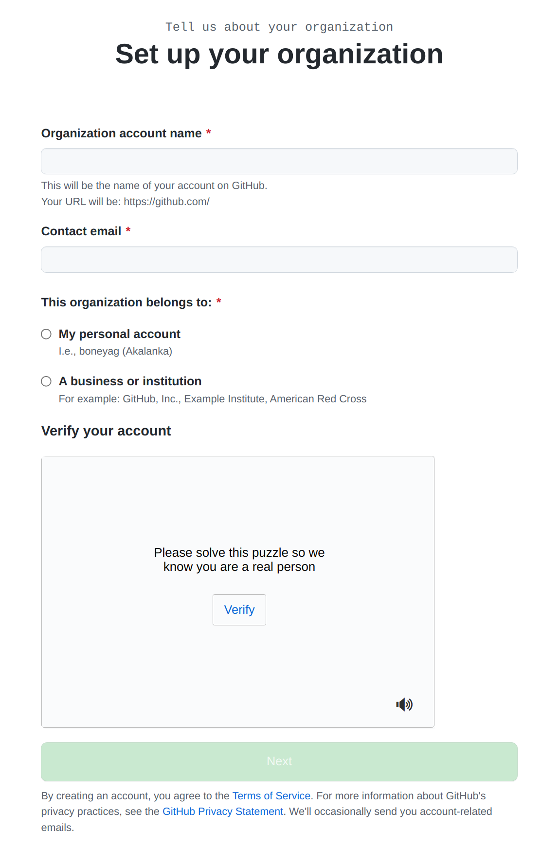
Continue...
Choose free option
Provide required information
Finish the process
Add team members as collaborators
Do the class participation exercise by creating a new repo
For the project, create a separate repo

